Slide 1
THE IDEAL-GAS EQUATION OF STATE

Slide 2
Equation of state
Any equation that relates the pressure, temperature, and specific volume
of a substance is called an equation of state.
There are several equations of state, some simple and others very complex.
The simplest and best-known equation of state for substances in the gas phase is the ideal-gas equation of state. (i.e. Pv = RT)
This equation adequately describes the PVT behaviour of gases for many practical purposes near ambient conditions of T and P.
Ideal gas
Ideal gas is a theoretical gas which obeys the ideal gas law (i.e. Pv = RT)
at all conditions of temperature and pressure.

Slide 3
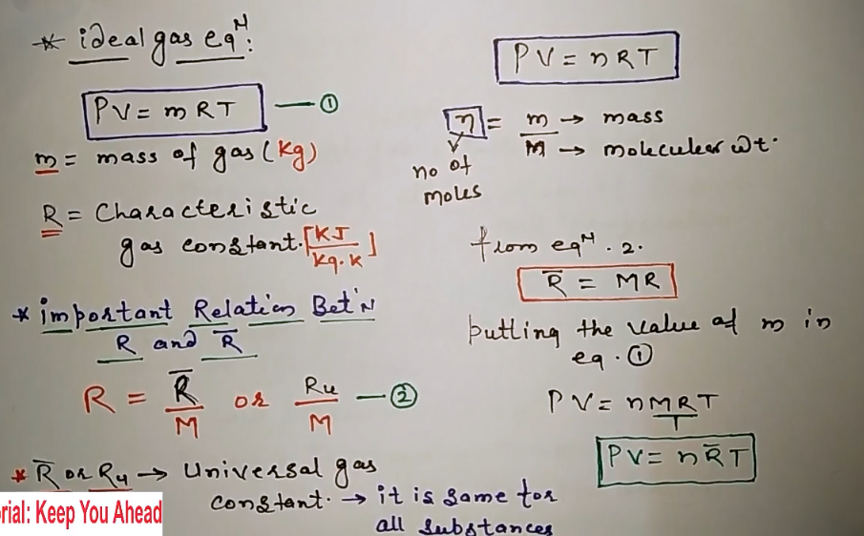


Slide 4
Real gas
The real gases which obeys the ideal gas law (i.e. Pv = RT) at two favourable conditions i.e. low pressure and high temperature
As these limits are approached, the molecules making up a gas become more and more widely separated, and the volume of the molecules themselves becomes a smaller and smaller fraction of the total volume occupied by the gas.
Furthermore, the forces of attraction between molecules become ever smaller because of the increasing distances between them.
The internal energy of a real gas depends on both pressure and temperature.
Pressure dependence results from intermolecular forces. Thus, in the absence of intermolecular forces, internal energy would depend on temperature only
Notes:
Gas and vapor are often used as synonymous words.
The vapor phase of a substance is customarily called a gas when it is above the critical temperature.
Vapor usually implies a gas that is not far from a state of condensation.

Slide 5
Ideal-gas state
It is the state of a gas comprised of real molecules that have negligible molecular volume and no intermolecular forces at all temperatures and pressures.
Two equations are fundamental to this state, namely the “ideal-gas law” and an expression showing that internal energy depends on temperature alone:
Ideal-gas law : Pv = RT
Internal energy: U = U(T )
Notes:
Although related to the ideal gas, it presents a different perspective. It is not the gas that is ideal, but the state, and this has practical advantages.
Ideal gas assumptions:
No intermolecular interaction
gas molecules volume is negligible

Slide 6
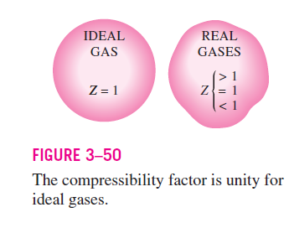
Compressibility factor (Z)
It is a correction factor to account for deviation from ideal-gas behaviour at a given temperature and pressure.
Z = Pv/RT or Pv = ZRT
For Ideal gases Z = 1 and For real gases Z<1 or Z>1
Z = Pv_{a}/RT a= actual = real gases
1 = Pv_{i}/RT i= ideal = ideal gases
By dividing
Z= v_{a}/v_{i} = actual/real volume / Ideal volume
Actual volume can be determined from experiments
Volume of the ideal gas can be determined from Pv = RT

Slide 7

The farther away Z is from unity, the more the gas deviates from ideal-gas behaviour.
Gases deviate from ideal-gas behaviour significantly at states near the saturation region and the critical point.
Gases behave differently at a given temperature and pressure, but they
behave very much the same at temperatures and pressures normalized with respect to their critical temperatures and pressures.
Here P_{R} is called the reduced pressure and T_{R} the reduced temperature.
The compressibility factor for all gases is approximately the same at the same reduced pressure and temperature. This is called the principle of corresponding states.

Slide 8
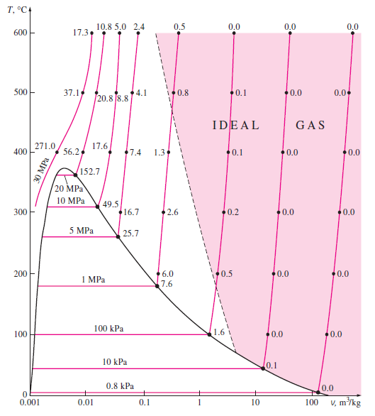
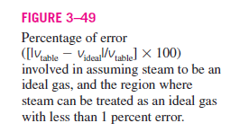

Slide 9
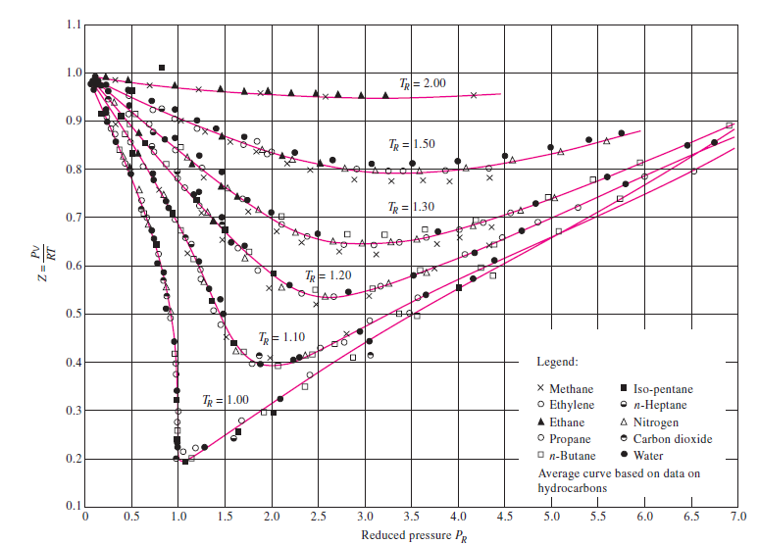


Slide 10
The experimentally determined Z values are plotted against P_{R} and T_{R} for several gases.
The gases seem to obey the principle of corresponding states reasonably well.
By curve-fitting all the data, we obtain the generalized compressibility chart that can be used for all gases
The following observations can be made from the generalized compressibility chart:
1. At very low pressures (P_{R} << 1), gases behave as an ideal gas regardless of temperature
2. At high temperatures (T_{R} > 2), ideal-gas behaviour can be assumed with good accuracy regardless of pressure (except when P_{R} >> 1).
3. The deviation of a gas from ideal-gas behaviour is greatest in the vicinity of the critical point.

Slide 11
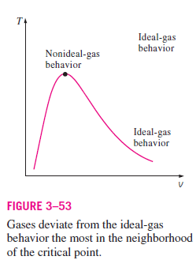
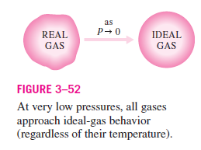

Slide 12

When P and v, or T and v, are given instead of P and T, the generalized
compressibility chart can still be used to determine the third property, but it would involve tedious trial and error.
Therefore, it is necessary to define one more reduced property called the pseudo-reduced specific volume v_{R} as
v_{R} is defined differently from P_{R} and T_{R}. It is related to T_{cr} and P_{cr} instead of v_{cr}.

Slide 13
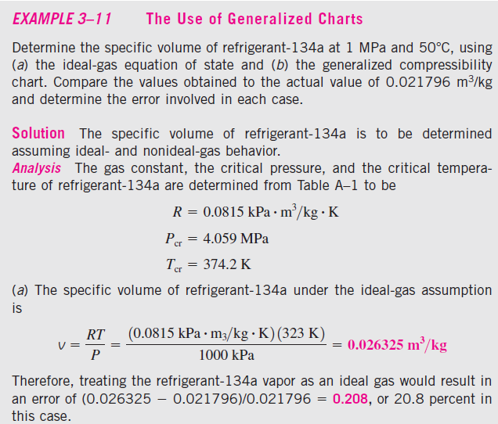

Slide 14
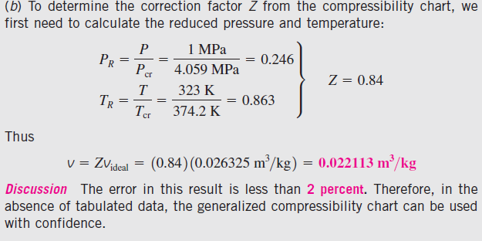

Slide 15
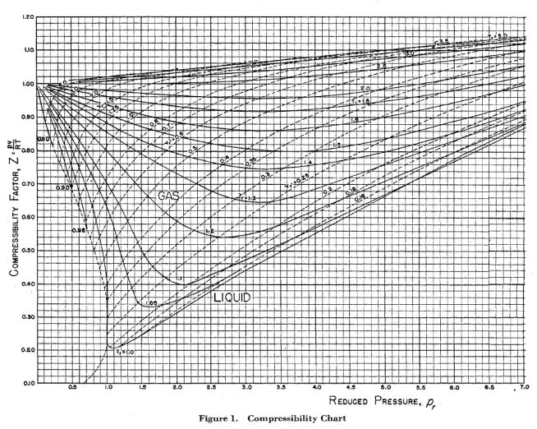

Slide 16

The ideal-gas equation of state is very simple, but its range of applicability
is limited.
It is desirable to have equations of state that represent the P-v-T
behaviour of substances accurately over a larger region with no limitations.
Such equations are naturally more complicated.
Van der Waals Equation of State
The van der Waals equation of state was proposed in 1873,
This equation is used to study the behaviour of real gases.
It has two constants that are determined from the behaviour of a substance at the critical point.

Slide 17
Van der Waals intended to improve the ideal-gas equation of state by
including two of the effects not considered in the ideal-gas model: the intermolecular attraction forces and the volume occupied by the molecules themselves.
The term a/v² accounts for the intermolecular forces, and b accounts for the volume occupied by the gas molecules.
In a room at atmospheric pressure and temperature, the volume actually occupied by molecules is only about one-thousandth of the volume of the room.
However, as the pressure increases, the volume occupied by the molecules becomes an increasingly significant part of the total volume.
Van der Waals proposed to correct this by replacing v in the ideal-gas relation with the quantity v - b, where b represents the volume occupied by the gas molecules per unit mass.

Slide 18
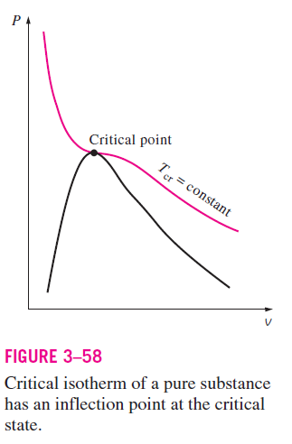

The determination of the two constants appearing in this equation is based on the observation that the critical isotherm on a P-v diagram has a horizontal inflection point at the critical point (Fig. 3–58).
Thus, the first and the second derivatives of P with respect to v at the critical point must be zero.
Notes:
a point of a curve at which a change in the direction of curvature occurs
The first derivative of a function is an expression which tells us the slope of a tangent line to the curve at any instant. if is positive, then must be increasing. If is negative, then must be decreasing.
The second derivative of a function ‘f’ measures the concavity of the graph of ‘f’. A function whose second derivative is positive will be concave up (also referred to as convex), meaning that the tangent line will lie below the graph of the function

Slide 19

By performing the differentiations and eliminating v_{cr}, the constants a and b are determined to be:
The constants a and b can be determined for any substance from the critical point data alone (Table A–1).
The accuracy of the van der Waals equation of state is often inadequate, but it can be improved by using values of a and b that are based on the actual behaviour of the gas over a wider range instead of a single point.

Slide 20
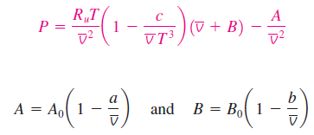
Despite its limitations, the van der Waals equation of state has a historical
value in that it was one of the first attempts to model the behaviour of real
gases.
The van der Waals equation of state can also be expressed on a unit mole
basis by replacing the v in by and the R by R_{u}
Beattie-Bridgeman Equation of State
The Beattie-Bridgeman equation, proposed in 1928, is an equation of state based on five experimentally determined constants.

Slide 21
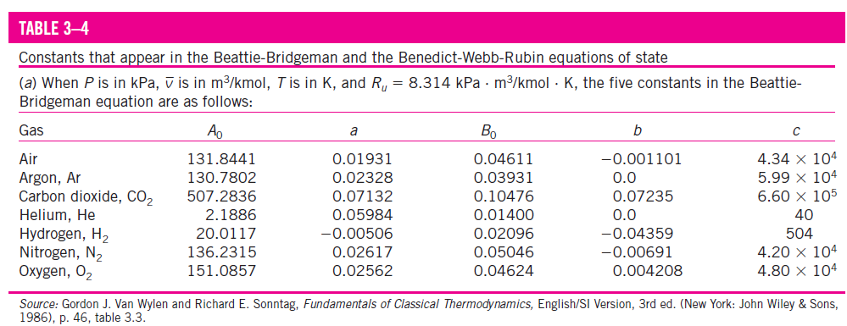
The constants appearing in the above equation are given in Table 3–4 for
various substances.
The Beattie-Bridgeman equation is known to be reasonably accurate for densities up to about 0.8 ρ_{cr}, where ρ_{cr} is the density of the substance at the critical point.

Slide 22

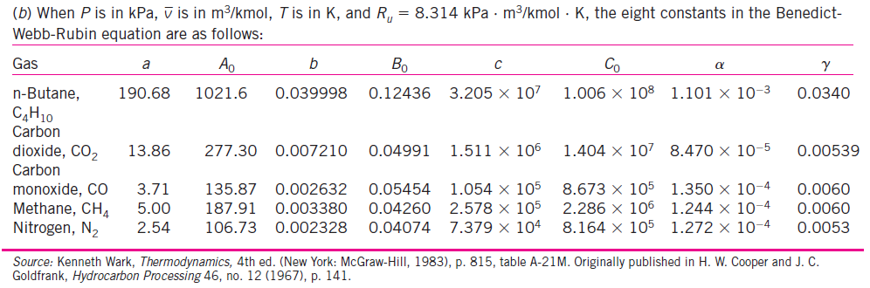
Benedict-Webb-Rubin Equation of State
Benedict, Webb, and Rubin extended the Beattie-Bridgeman equation in
1940 by raising the number of constants to eight.
The values of the constants appearing in this equation are given in Table 3–4. This equation can handle substances at densities up to about 2.5 ρ_{cr}.

Slide 23
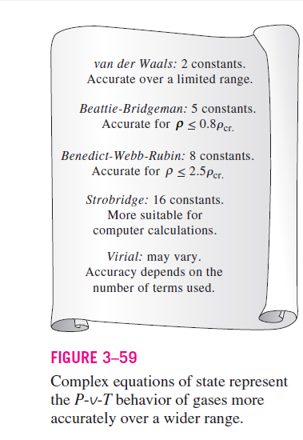

Slide 24
Virial Equation of State

Slide 25
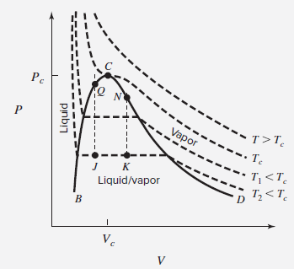
Volumetric data for fluids are useful for many purposes, from the metering of fluids to the sizing of tanks.
Data for V as a function of T and P can of course be given as tables. However, expression of the functional relation f (P, V, T) = 0 by equations is much more compact and convenient.
The virial equations of state for gases are uniquely suited to this purpose.
Isotherms for gases and vapors, lying to the right of the saturated-vapor curve CD in Figure, are relatively simple curves for which V decreases as P increases
Notes:
Sizing: estimate or measure something's dimensions.

Slide 26


PV along an isotherm may be expressed as a function of P by a power series:
If b = aB', c = aC', etc., then,
In principle, the right side is an infinite series. However, in practice a finite number of terms is used.
In fact, PVT data show that at low pressures reducing the above equation after two terms usually provides satisfactory results.

Slide 27
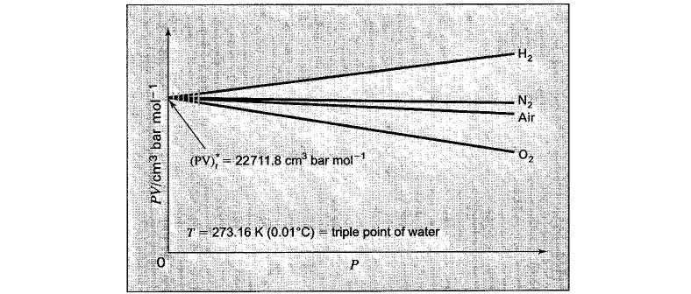
Parameters B’, C’, D’ in above equation are species dependent and functions of temperature, but parameter “a” is the same function of temperature for all species.
This is shown experimentally by measurements of volumetric data as a function of P for various gases.
The limiting value of PV as P → 0 is the same for all of the gases.
Denoting this zero-pressure limit by an asterisk provides:
( PV ) * = a = f ( T )

Slide 28

(PV)* is directly proportional to T, with R as the proportionality constant:
( PV ) * = a ≡ RT (a)
Assigns the value 273.16 K to the temperature of the triple point of water (denoted by subscript t):
( PV )_{t}* = R × 273.16 K (b)
Division of Eq. (a) by Eq. (b) gives

Slide 29


From eq (b)
The accepted experimental value of ( PV ) t* is 22,711.8 bar・cm³ ・ mol⁻¹, from which

Slide 30





Two Forms of the Virial Equation
We know
With a = RT
Parameters B′ and B are second virial coefficients; C′ and C are third virial coefficients, and so on.

Slide 31

An alternative expression for Z is also in common use
Both of these equations are known as virial expansions, and the parameters B′, C′, D′, etc., and B, C, D, etc., are called virial coefficients.

Slide 32
For ideal gases, where no molecular interaction exists, Virial coefficients B & C are zero. The virial expansion would then reduce to
For a real gas, molecular interactions do exist, and exert an influence on the observed behavior of the gas.
As the pressure of a real gas is reduced at constant temperature, V increases and the contributions of the terms B/ V , C/ v², etc., decrease.

Slide 33
The P-v-T behaviour of a substance can be represented accurately with the virial equation of state over a wider range by including a sufficient number of terms.
Complex equations represent the P-v-T behavior of substances reasonably
well and are very suitable for digital computer applications.
For hand calculations, however, it is suggested that the reader use the property tables or the simpler equations of state for convenience.

